Slide 1

IR.T
PRESENTATION

Slide 2

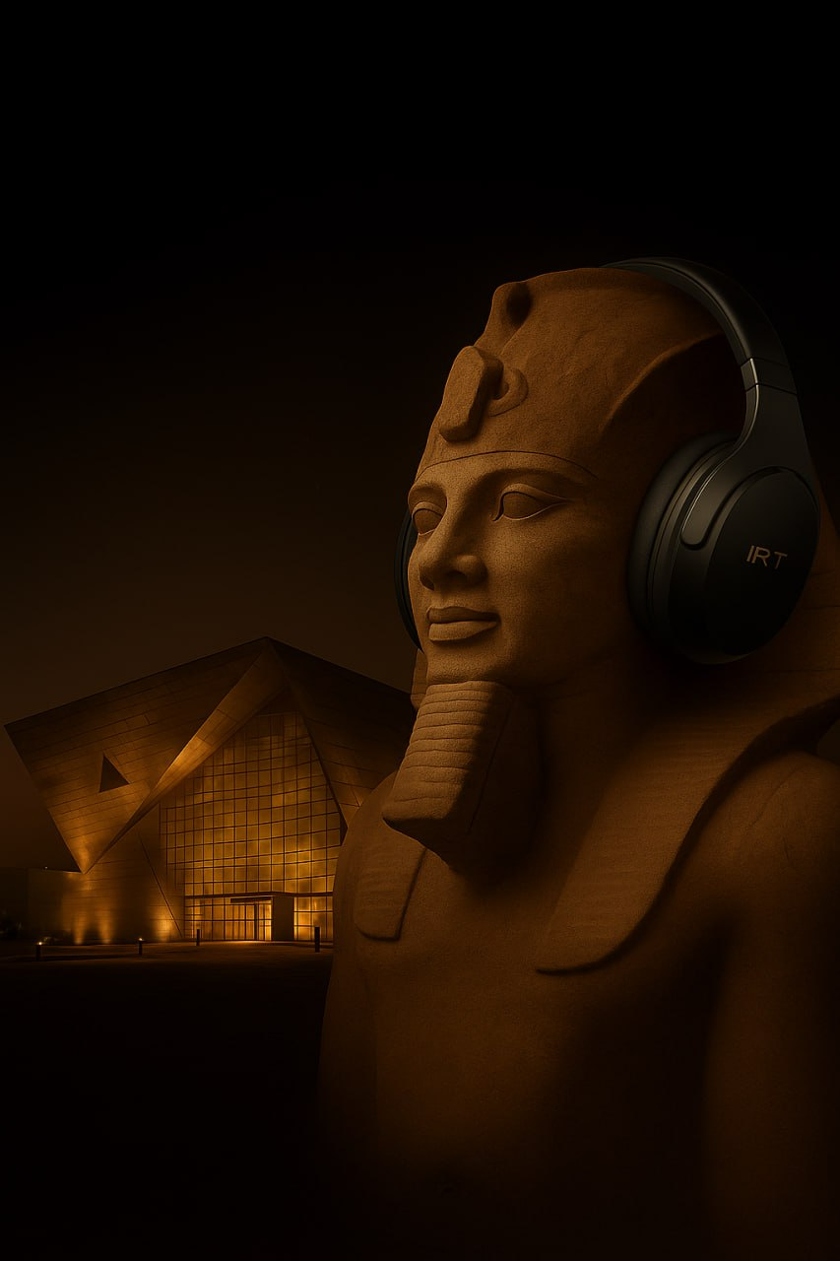
Project proposition
Smart headphones offering self-guided audio tours in museums and archaeological sites.
Replaces traditional tour guides with immersive, multilingual storytelling.
QR codes provide instant access to historical audio content.
Works offline for use in low-connection areas.
Modern, personalized cultural tourism experience with rental or purchase options.

Slide 3
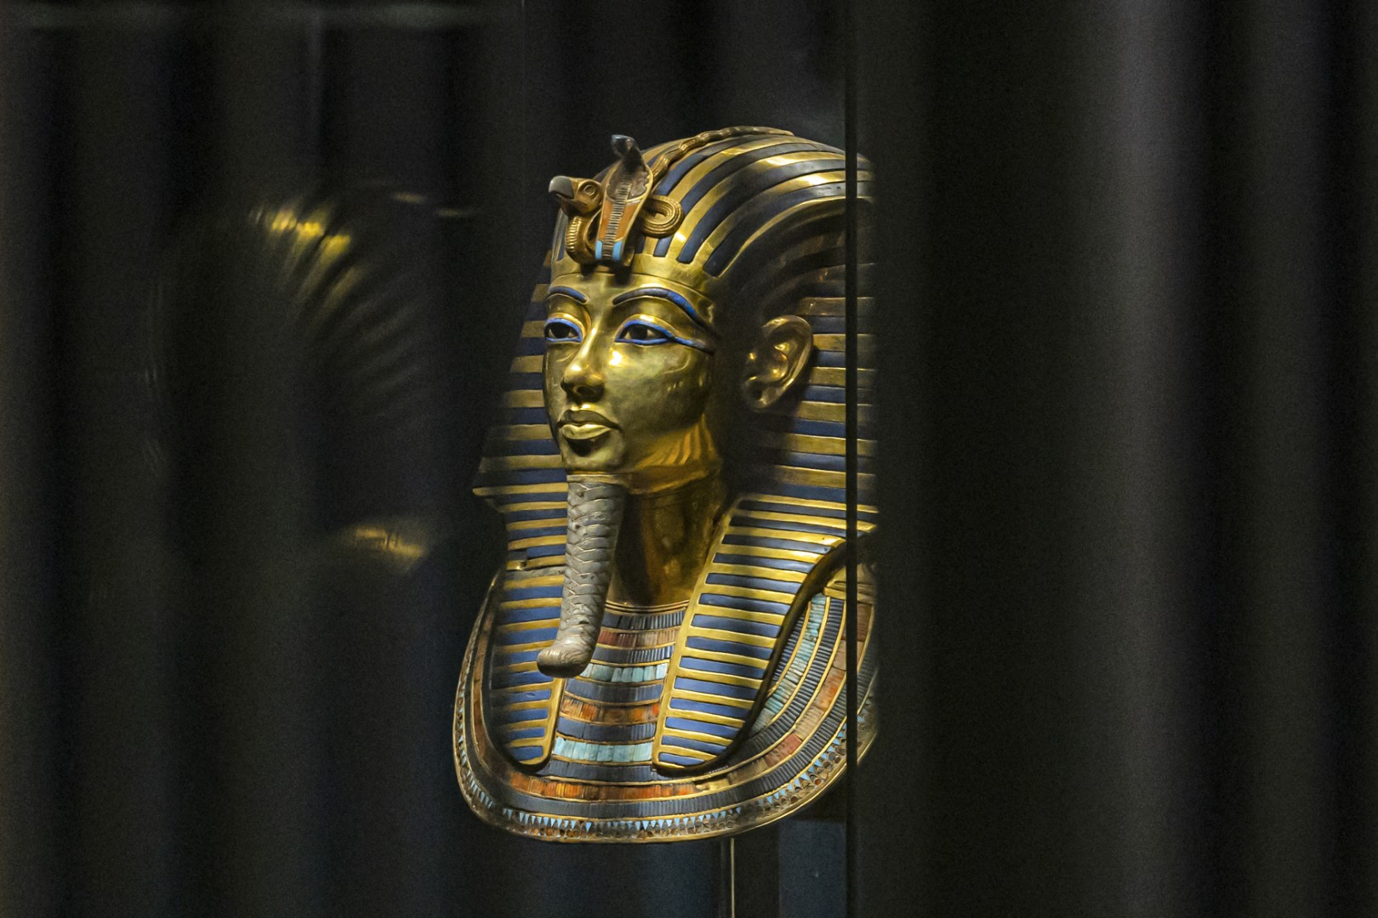
STRATEGY

Slide 4
- IR.T connects the past with the present through immersive audio storytelling. - We aim to make Egyptian heritage accessible, engaging, and enjoyable for everyone. - Our long-term goal: expand nationwide and become a leading tourism-tech brand.
- Offer smart audio-guide headsets for museums and heritage sites. - Provide multilingual, offline storytelling for visitors of all ages. - Enable families, children, and international tourists to explore history freely and comfortably.
Ages: 18–45: Family-friendly, educational visits ,Simple and comfortable experiences.
Nationality: Europeans ,Middle Eastern ,North Americans ,Asians
Platforms: Instagram, Facebook, TikTok
- Smart lightweight headsets + companion mobile app.
- Two modes: Tourist Mode & Kids Mode (simplified, educational content)
- Immersive storytelling audio , Offline accessibility , Ulti-language support & Accessibility features for people with disabilities.
VISION
MISSION
Target
Audience
Competitive Advantage

Slide 5
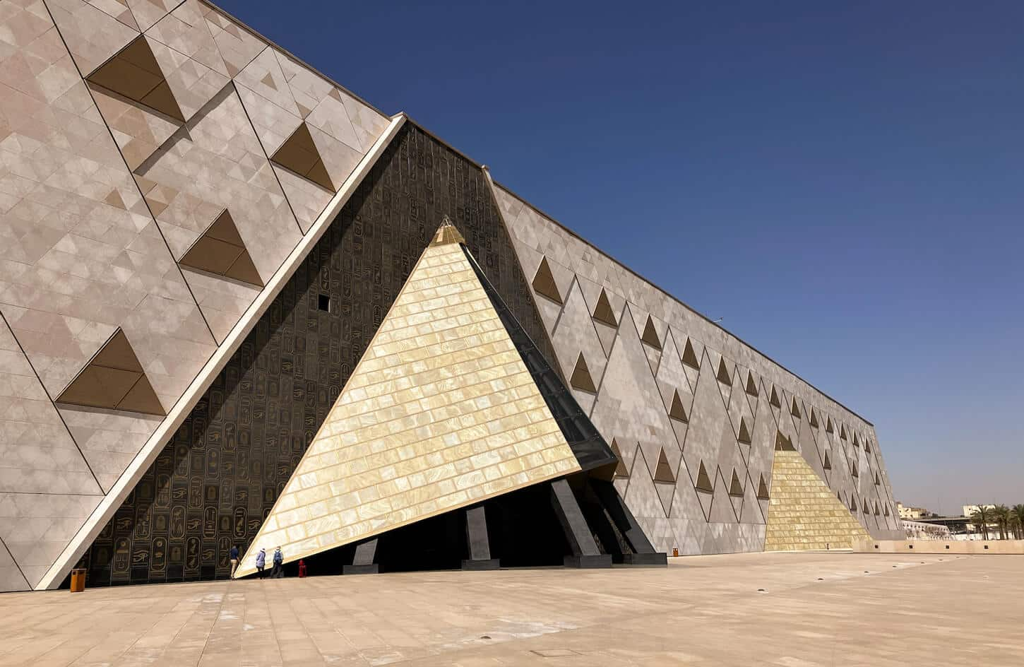
Content
Creation

Slide 6

STEP 1 : Research & Planning Phase
GOAL: Understanding the site and audience to design a well-structured tour with clear key stops and defined timing.
GOAL: Creating engaging, simple, story-driven audio scripts enriched with interesting facts and timed for clear, concise delivery.
STEP 2 : Scriptwriting
GOAL: Creating engaging, simple, story-driven audio scripts enriched with interesting facts and timed for clear, concise delivery.
STEP 3 : Audio Production

Slide 7
GOAL: Enhancing the audio tour with supportive visual materials like photos, QR codes, and simple illustrations for easier navigation and engagement.
STEP 4 : Design & Visual
GOAL: Testing the tour with real users to ensure clear, accurate, user-friendly audio content, then refining it based on feedback.
STEP 5 : Testing & Review

Slide 8
Content Plan
CAMPAIGN | MARKET | SCHEDULE | CONTENT TYPE | Caption | CHANNEL
can you hear it? | Egypt | 07 Oct 2025 | 🖼️ Post | Stay tuned | All
Cover photo | Egypt | 10 Oct 2025 | 🖼️ Post | Wish your museum visit felt like a story | Facebook
I.RT experience | Egypt | 10 Oct 2025 | 🎥 Video | IR.T = The Eye of Horus | All
I.RT Meaning | Egypt | 15 Oct 2025 | 🖼️ Post | !يتكلم هيبدأ والتاريخ أيام 5 فاضل | All
GEM Countdown | Egypt | 27 Oct 2025 | 🖼️ Post | countdown for 5 days | All
GEM Countdown | Egypt | 27Oct 2025 | 🎥Reel | very soonالافتتاح ✅ | Instagram
GEM opening | Egypt | 31Oct 2025 | 📱STORY | GEM now is open | All
Facebook | Egypt | 01 Nov 2025 | 🖼️ Post | التى من اجلها تشرق الشمس | FACEBOOK
GEM media coverage | Egypt | 02 Nov 2025 | 🎥Video | ها عرفت مين ملك | Facebook
Guess the king | Egypt | 02 Nov 2025 | 🖼️ Post | تخمينكم كان صح | All
King TUT | Egypt | 03 Nov 2025 | 🖼️ Post | الملك الذهبى | All
King TUT | Egypt | 08 Nov 2025 | 🎥 Reel | Still iconic | All
Meta AD | Egypt | 10 Nov 2025 | 🖼️ Post | مش مجرد سماعة | All

Slide 9
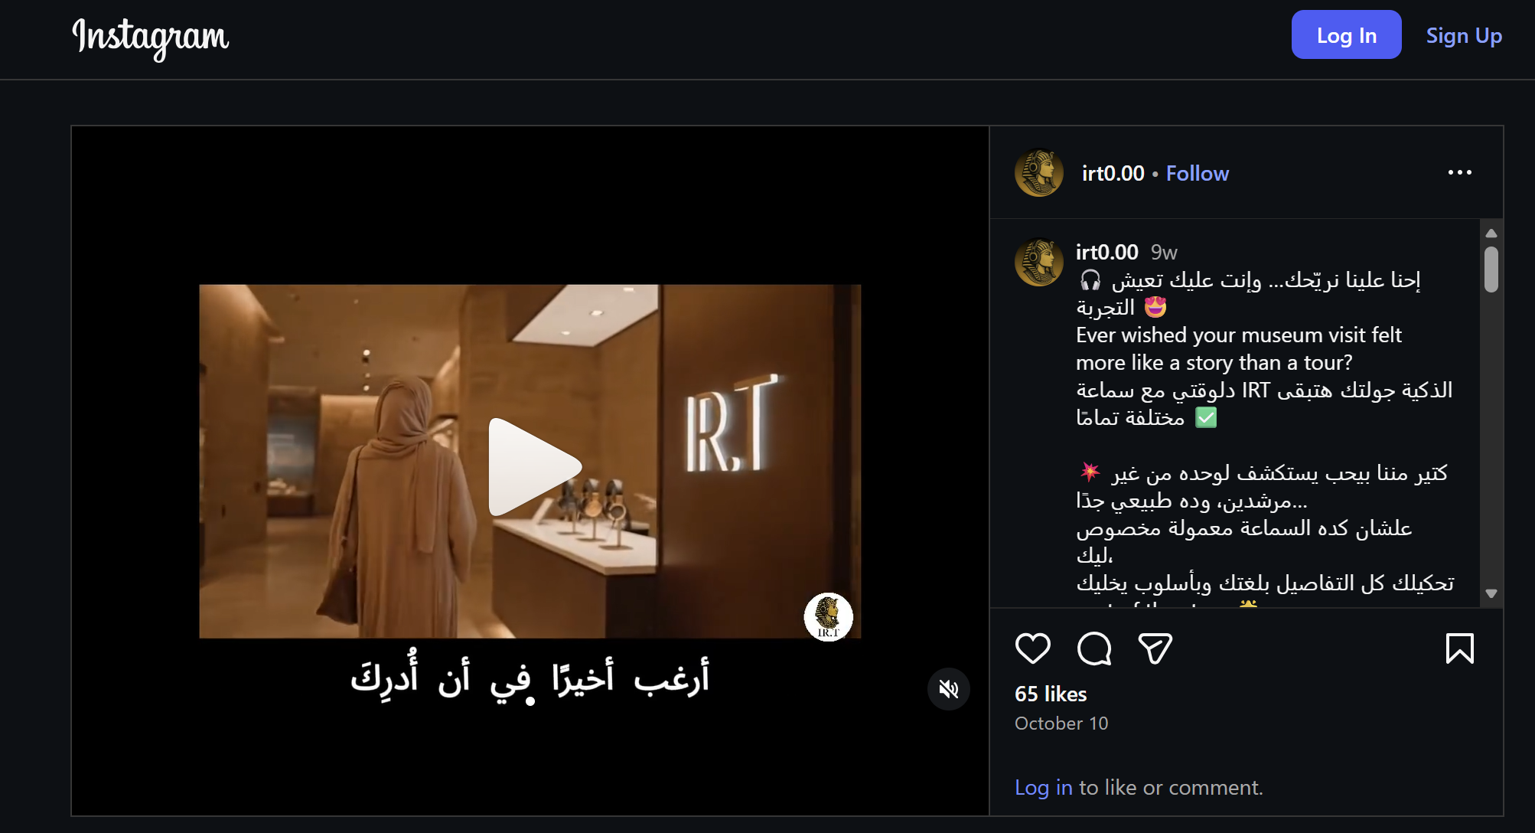
ONE OF OUR POSTS
https://www.instagram.com/p/DPooSBYiOSQ/?igsh=MnI2YjVoZmdjYmtl

Slide 10
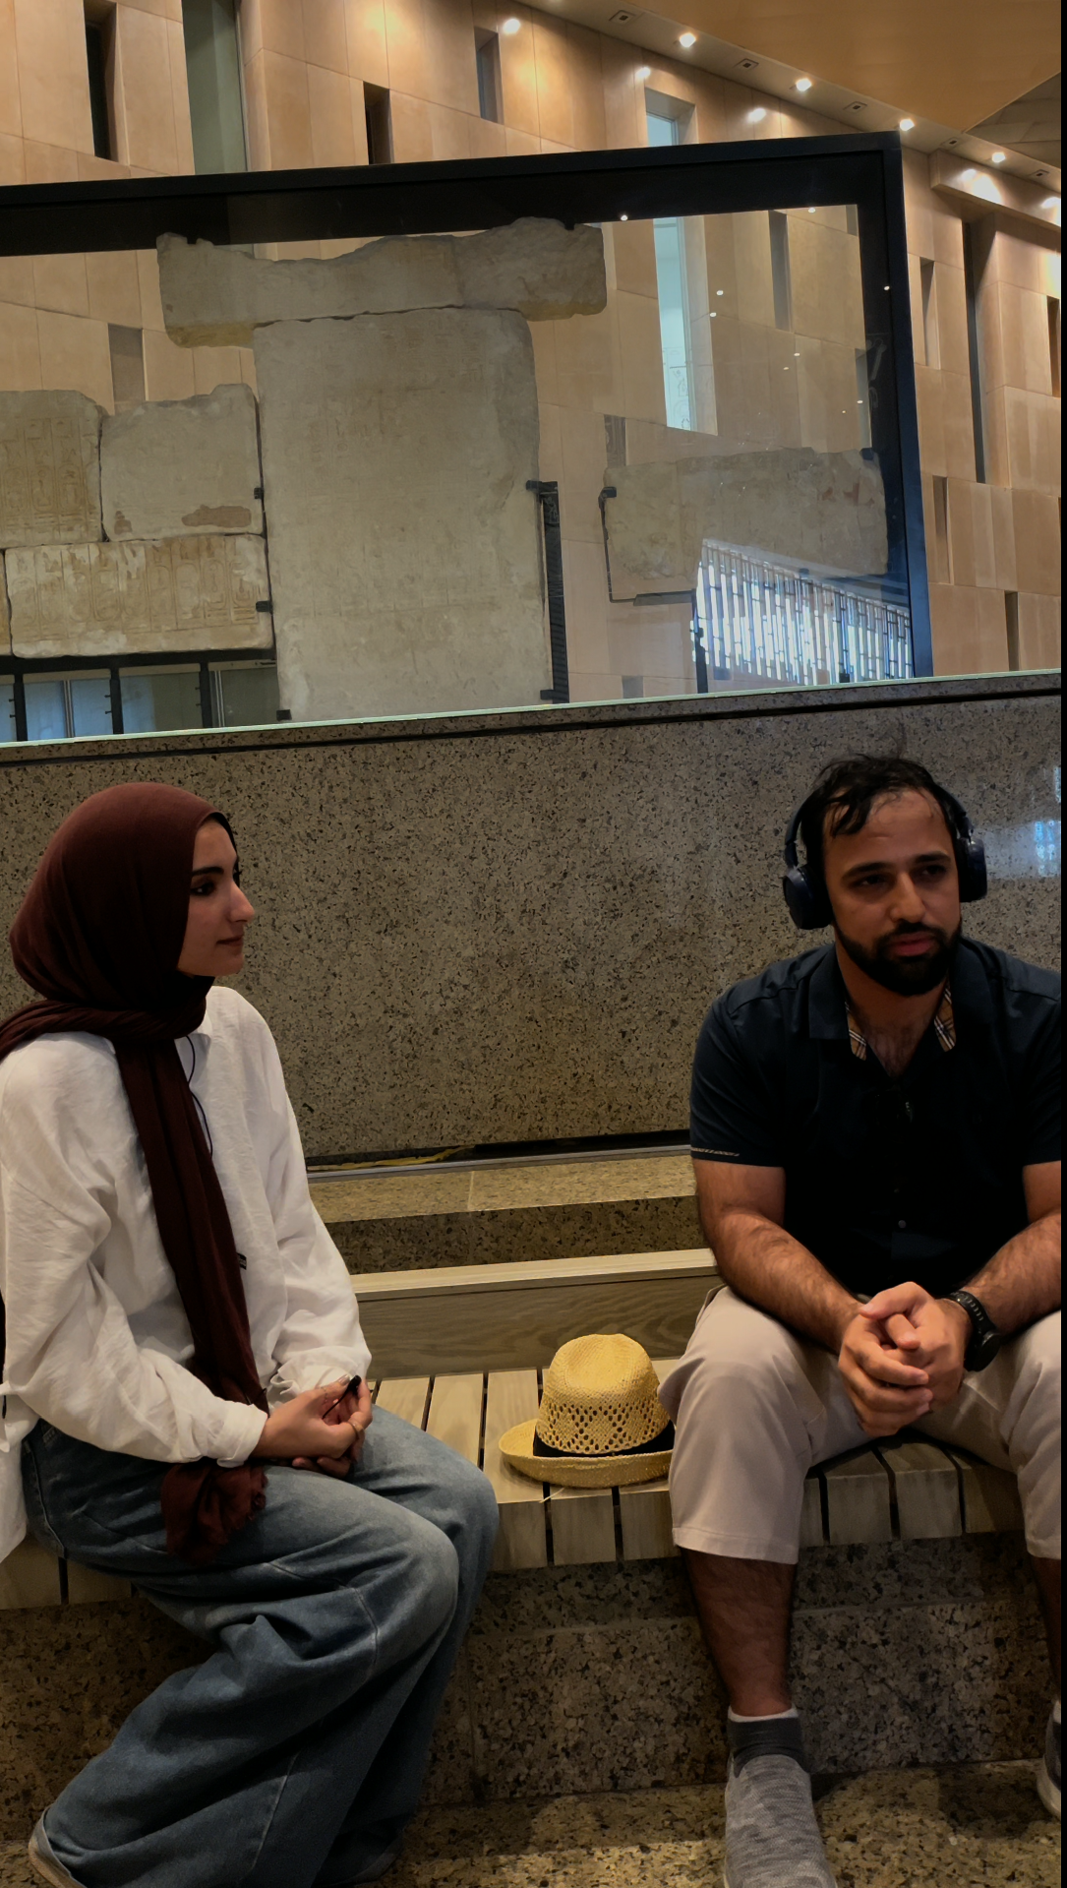
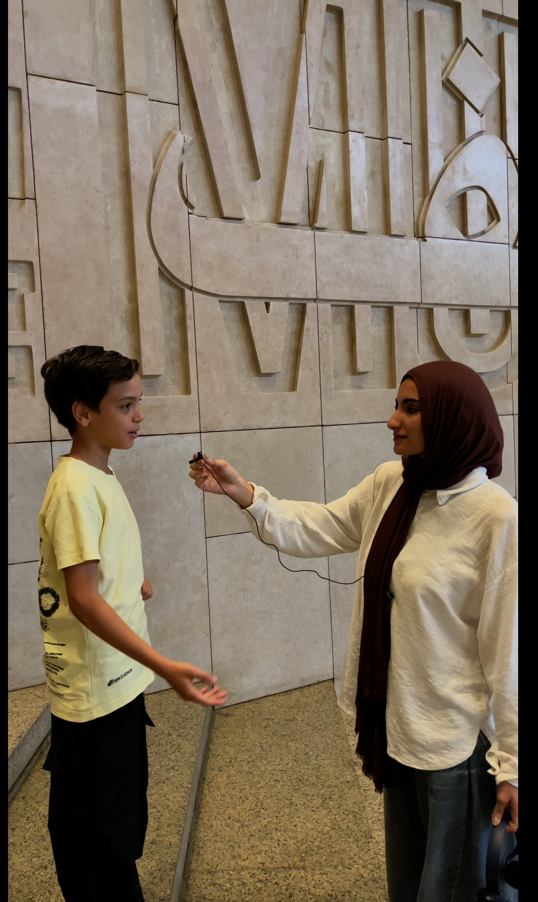
SURVEY
We engaged real visitors during the GEM opening to observe how they interact with historical content. The survey confirmed strong interest in interactive, multilingual audio experiences.
Watch a clip of the interviews: https://drive.google.com/file/d/1SUt-IEd_7VWxnHe8USksI-88910coeSp/view?usp=sharing
We tested IR.T with real international visitors, not just ideas. Tourists shared their needs and reactions during on-site interviews.
Visitors from different countries preferred audio storytelling over reading texts. Many highlighted language clarity and freedom of movement as key benefits.
Kids Mode Validation : IR.T includes children’s voice narration to create an emotional connection with history. Kids engaged faster and remembered more when stories matched their tone.

Slide 11
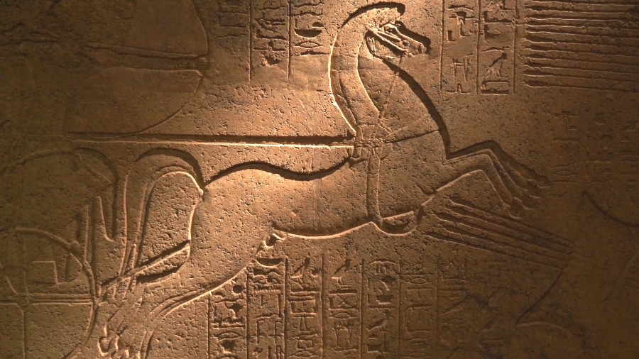
Results
This Photo by Unknown Author is licensed under CC BY-NC-ND

Slide 12
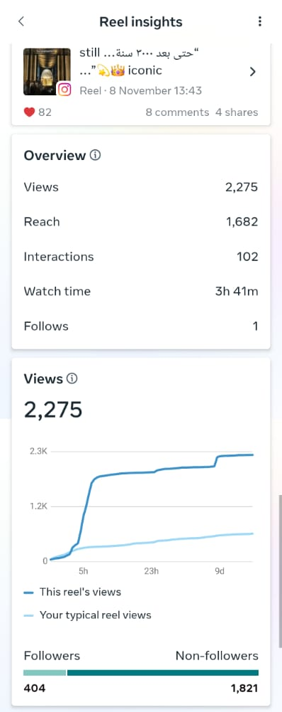
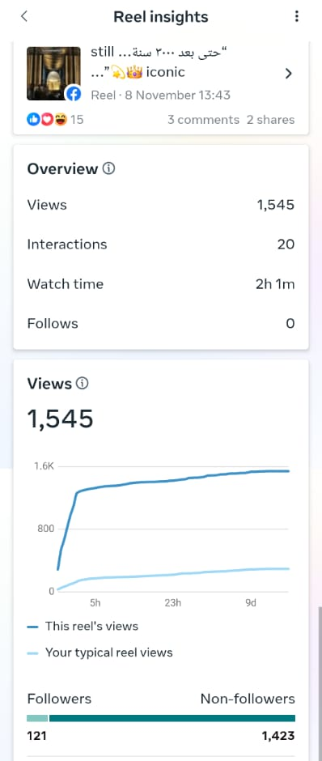
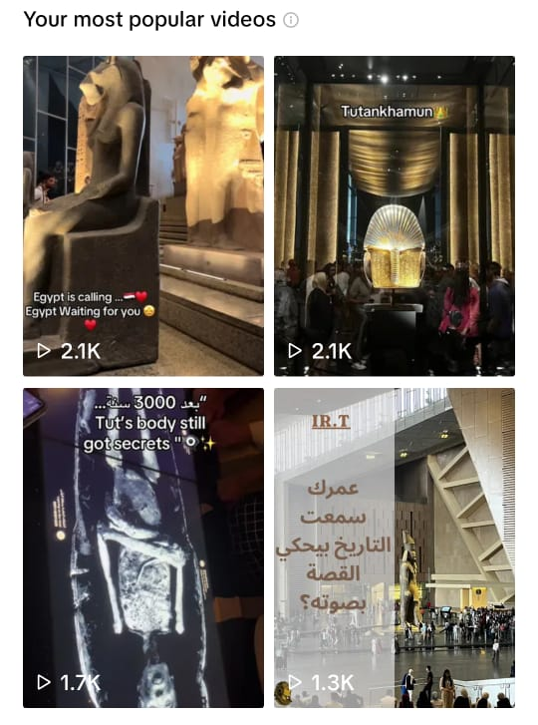
SOCIAL MEDIA PERFORMANCE
1. Instagram
Total Views: 15,000
New Followers: 185
Content Interaction: 609
2. Facebook
New Followers: 85
Total Views: 40,000
Content Interaction: 373
3. TikTok
Followers: 87
Likes: 573
Total Views: 2,138
Audience Reached: 1,766

Slide 13
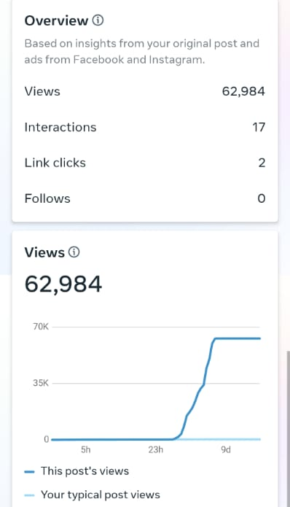
AD PERFORMANCE
Ad Views: 62.8K Reach: 51K
Analysis:
The paid ad had a strong impact on reach and total views.
Follower growth rate is excellent for the campaign duration.

Slide 14

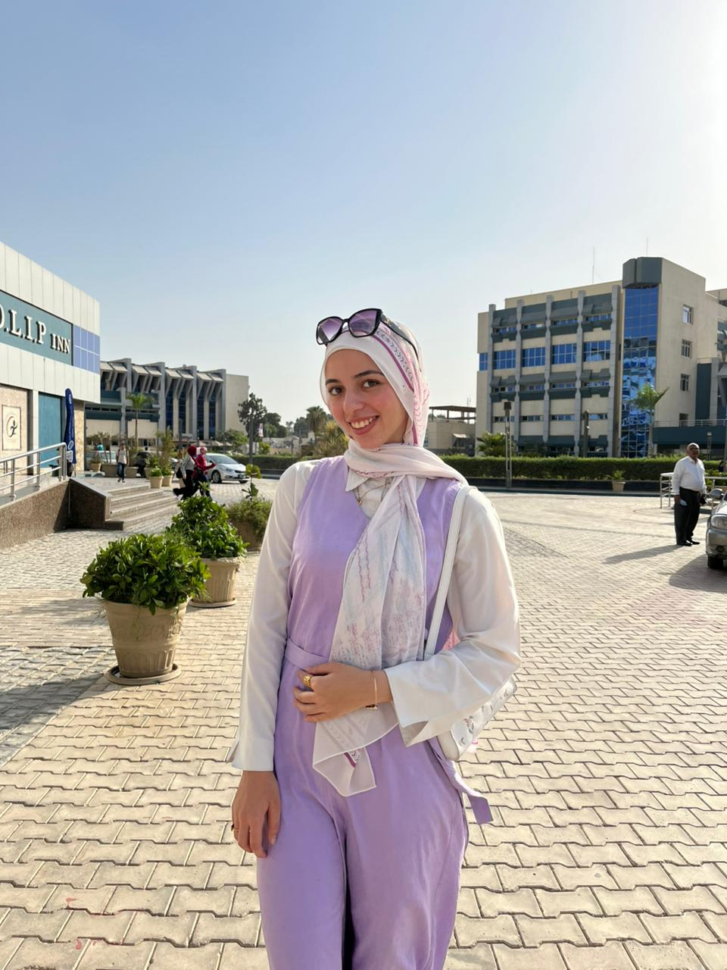
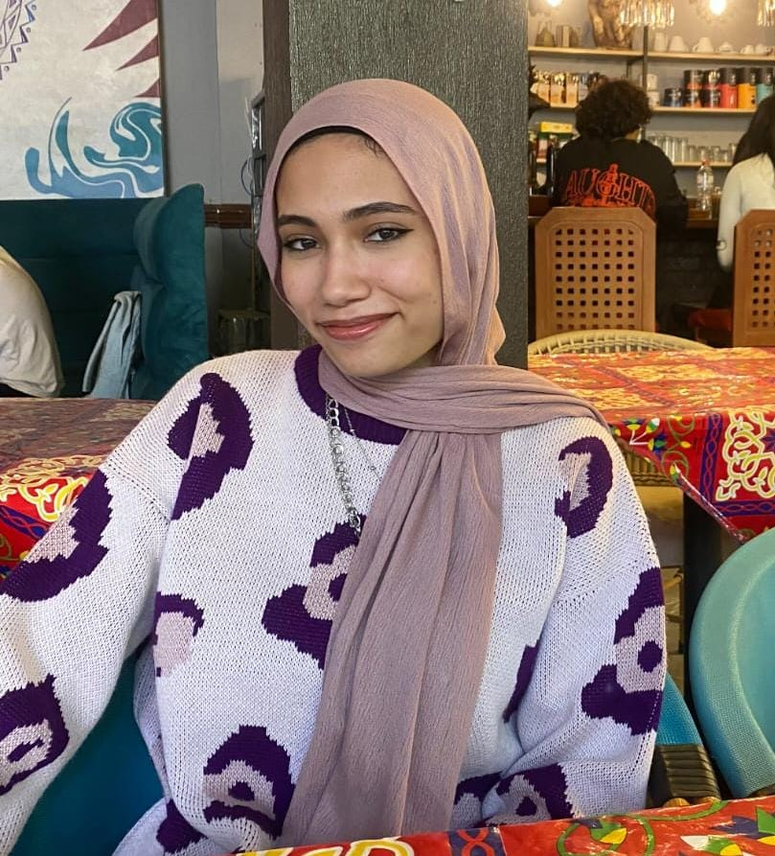
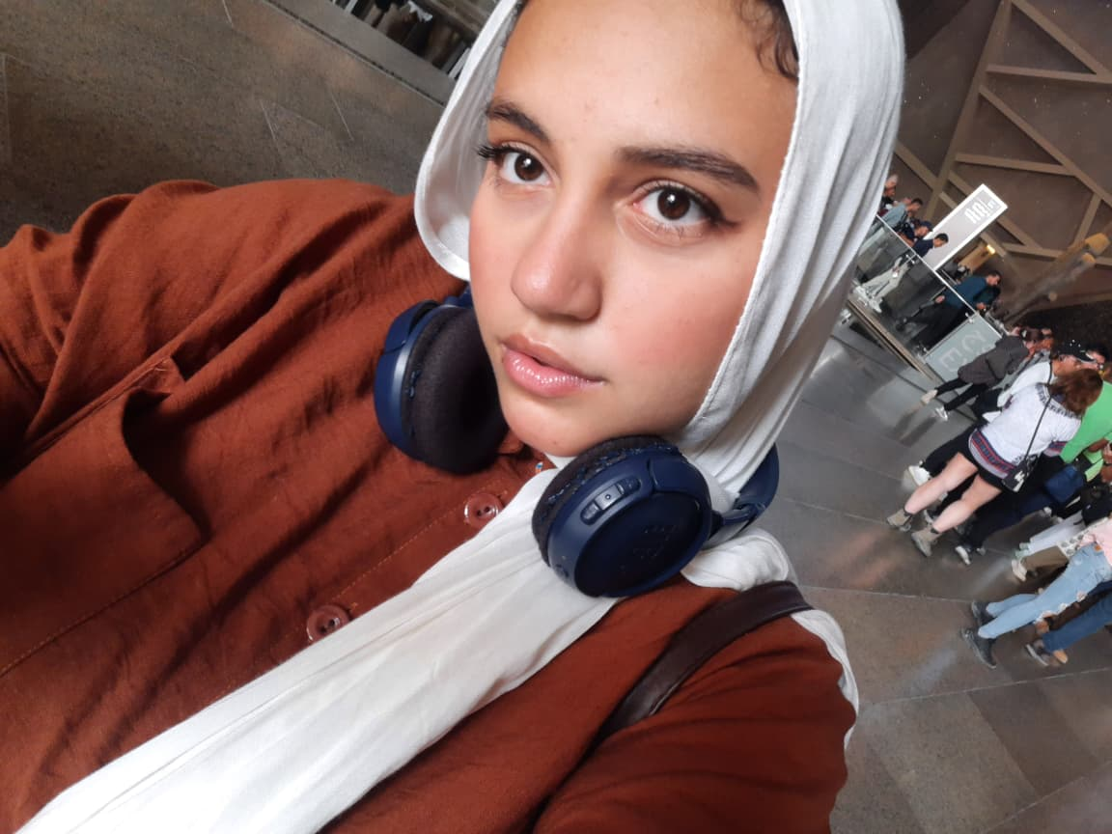
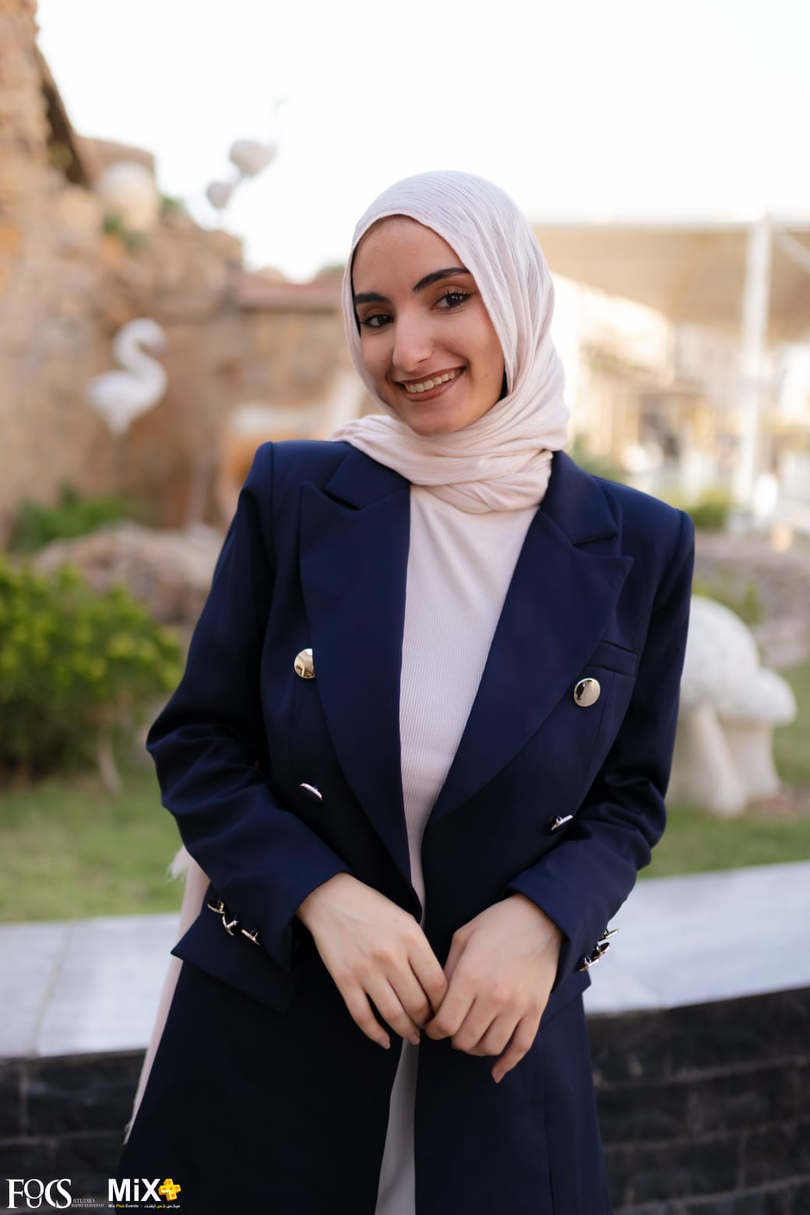
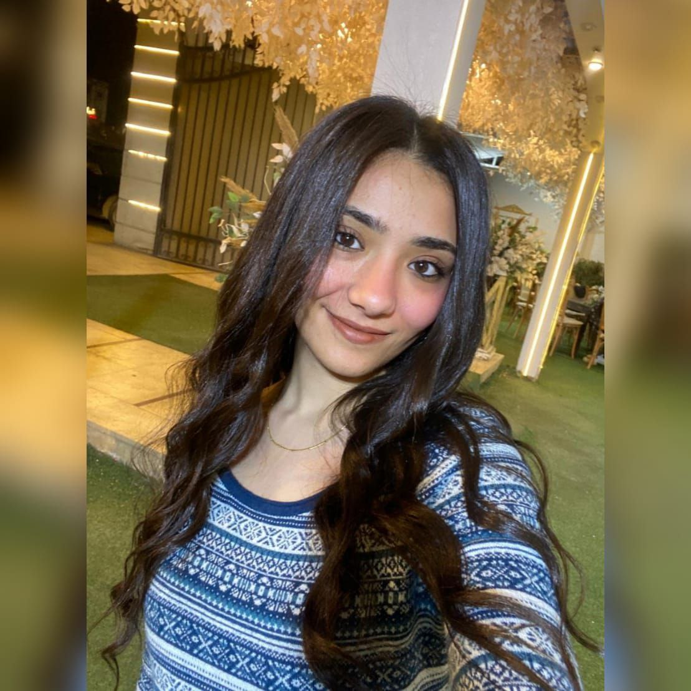
THE TEAM
NOUR ALLAH
AHMED
TOQA HUSSIEN
Noor El Houda
BELAL
MENNA HUSSIEN
MOHRAIL ATYIA
OUR MENTOR AND INSTRACTOR : YOUSEEF ABDEL SABOUR

Slide 15
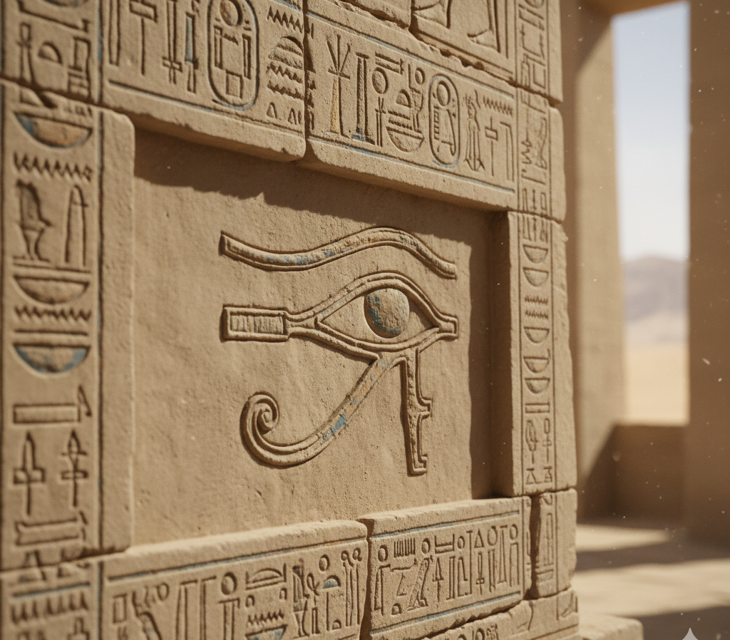
THANK YOU

